Slide 1

LVMH
MUSEACO
MUSIC x EASY x COLLAB
DATA-DRIVEN SYNERGY FOR PERFECT BRAND-ARTIST COLLABORATIONS
TEAM 03
Vinayak SINGH, Sai PAWAR, Sakshi THOKE, Jaturaporn NUSATI, Daniel DE PAULA, Haotian ZHENG

Slide 2

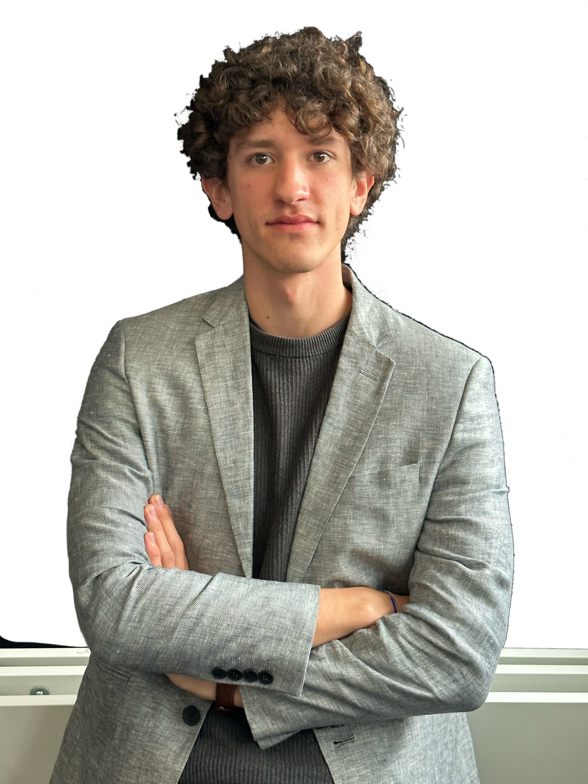
Louis Vuitton
DANIEL
Brand Communication Manager

Slide 3
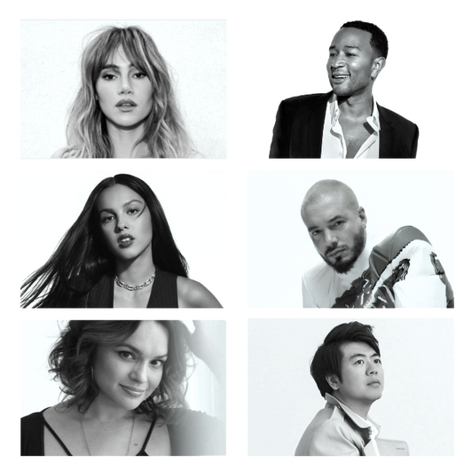
MUSEACO
MUSIC x EASY x COLLAB
Data-driven synergy for perfect brand-artist collaborations

Slide 4
FRAMEWORK
Artist
Selection
Selected Artist
Artist as a Recommendation
Artist Contract Management
Authorized Contract
Manage Artist Performance
Maturity Development Request
Manage Artist Maturity
Corrective Action Plan (CAP)

Slide 5
ARTIST SELECTION
1
New-to-the-maison Artists
2
Artist with specific values
3
Past collaboration Artists

Slide 6
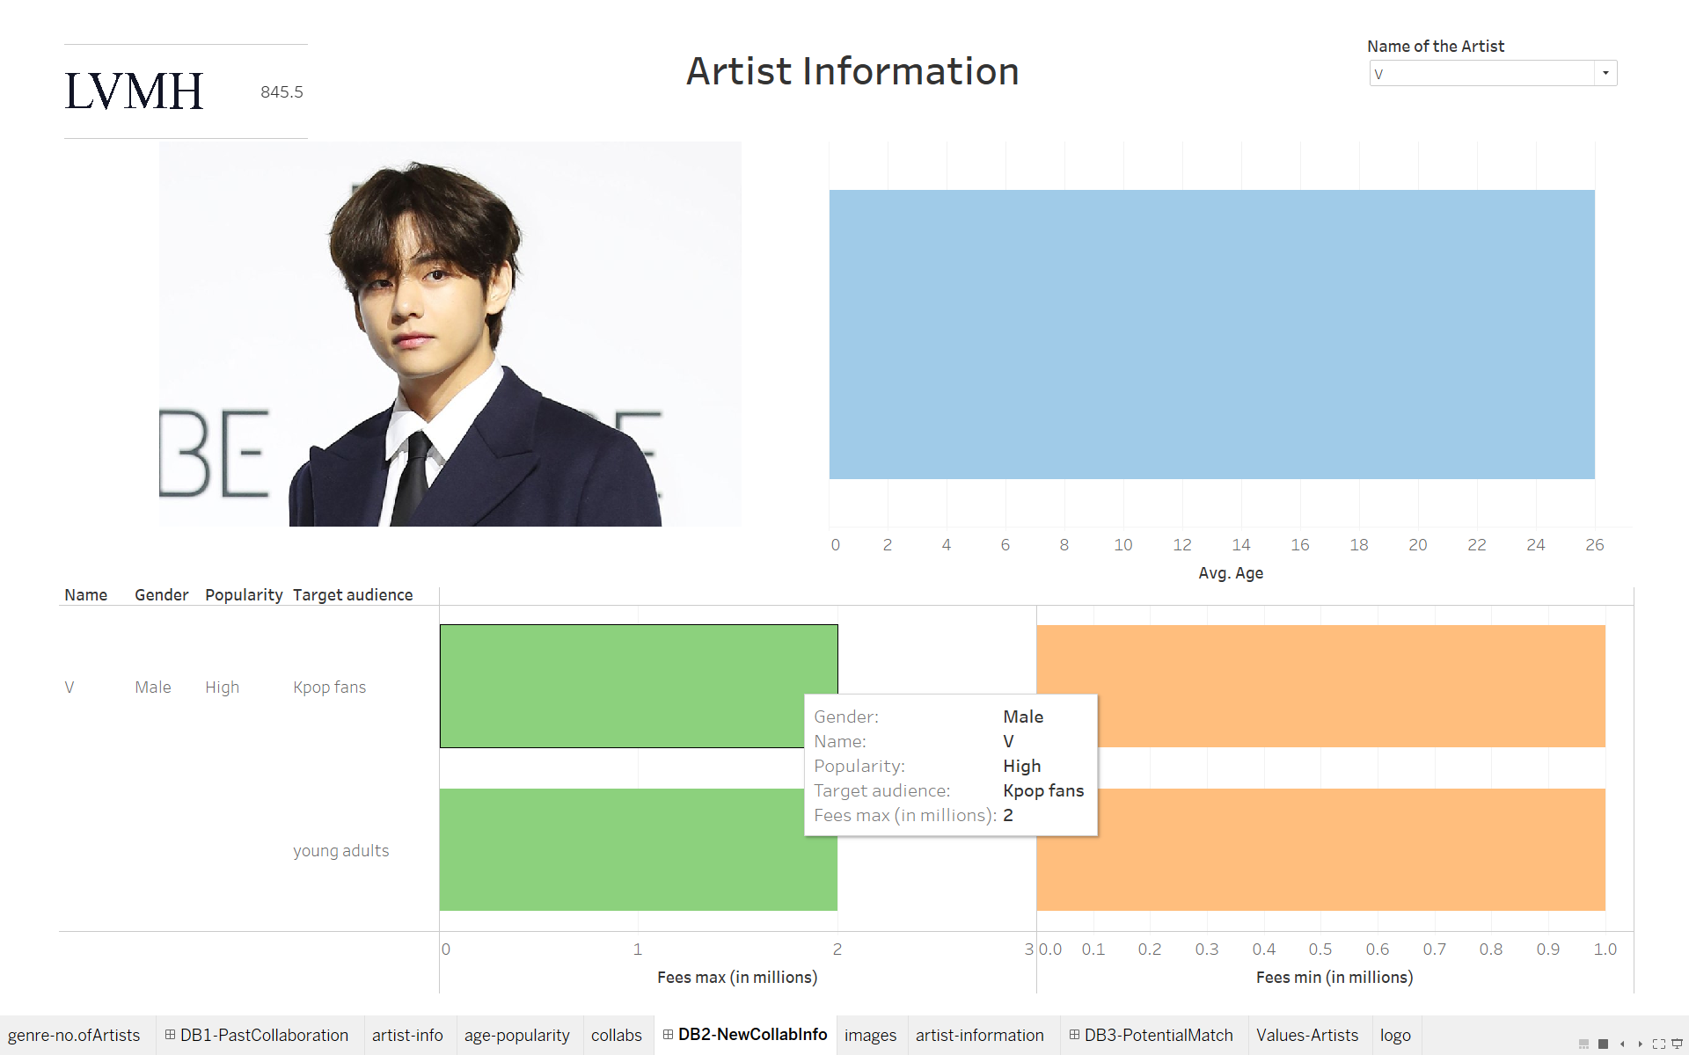
New-to-
the-Maison Artists

Slide 7
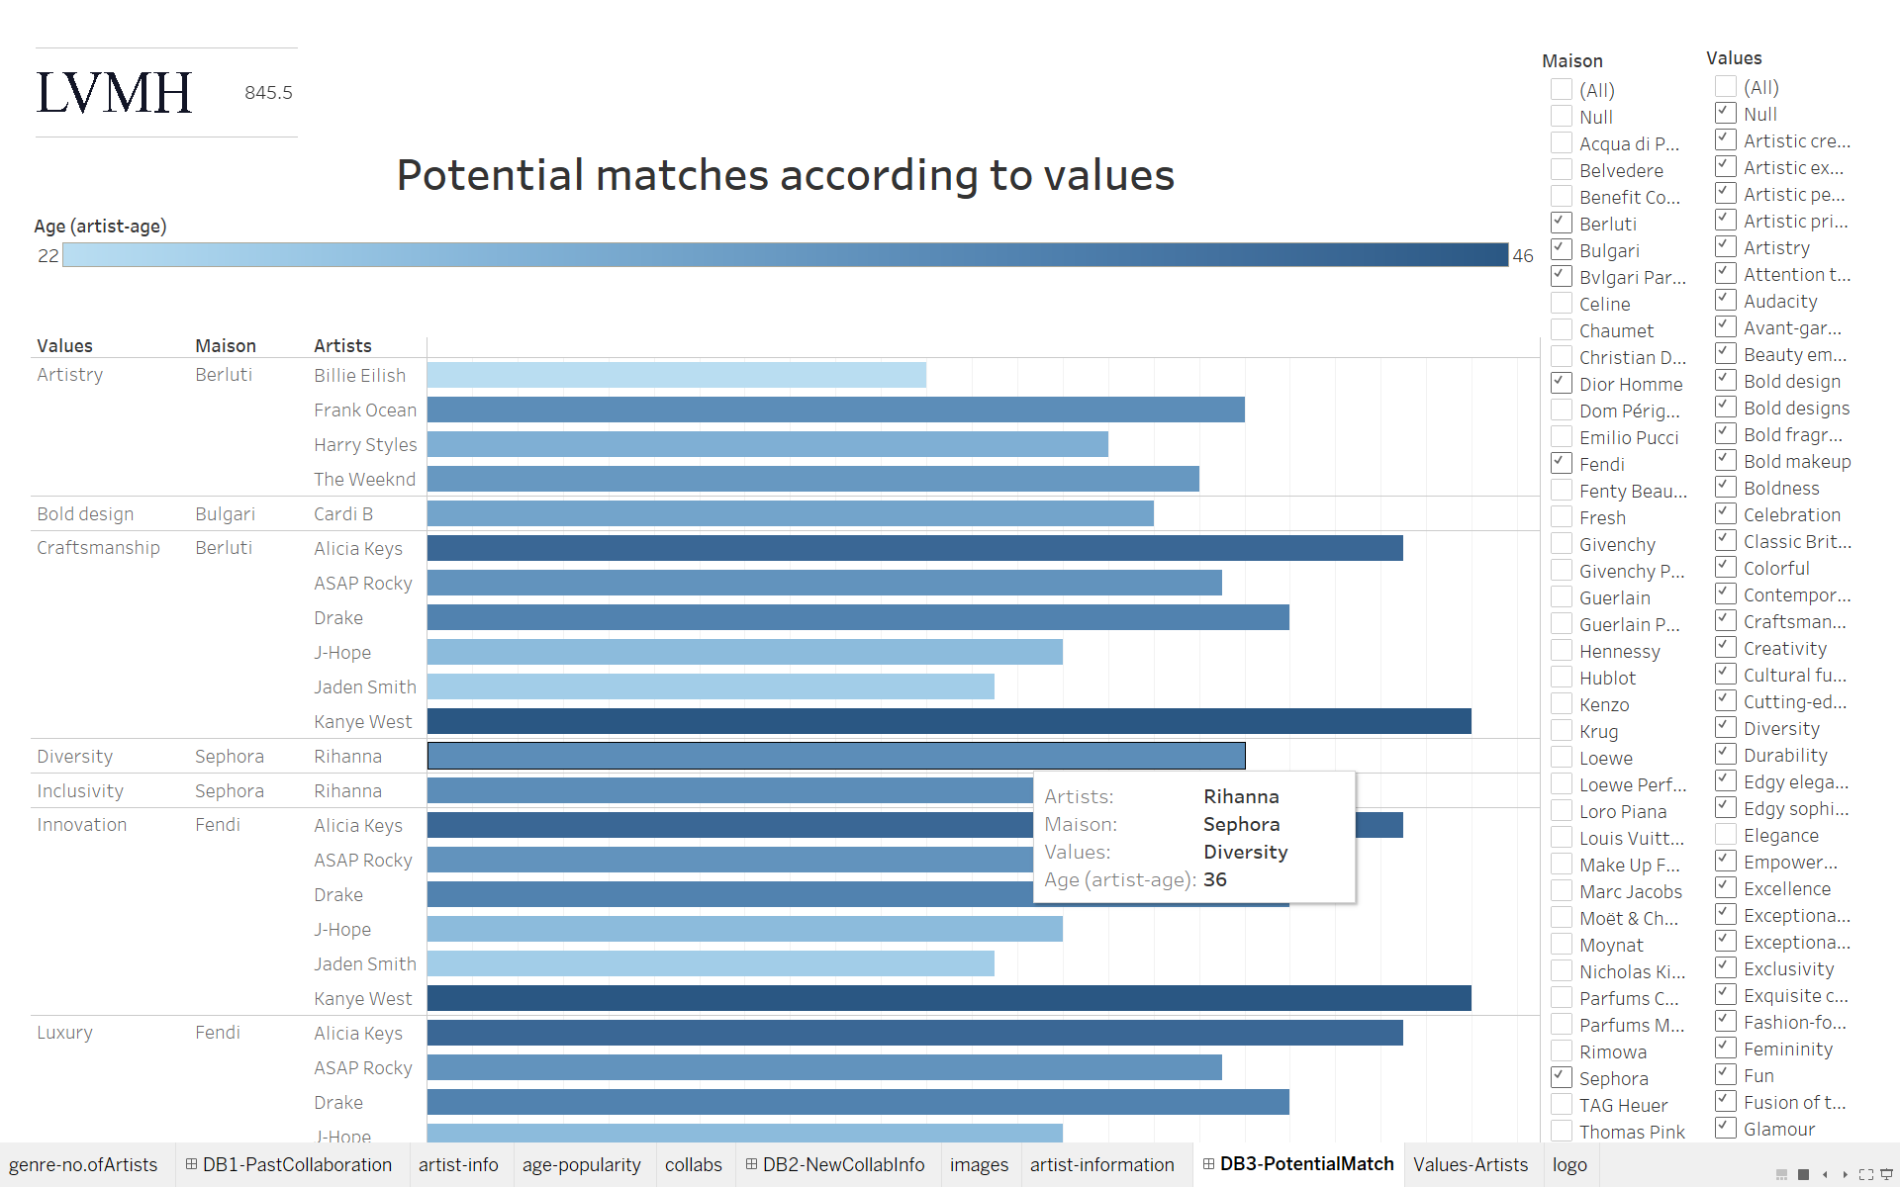
Artist
with specific values

Slide 8
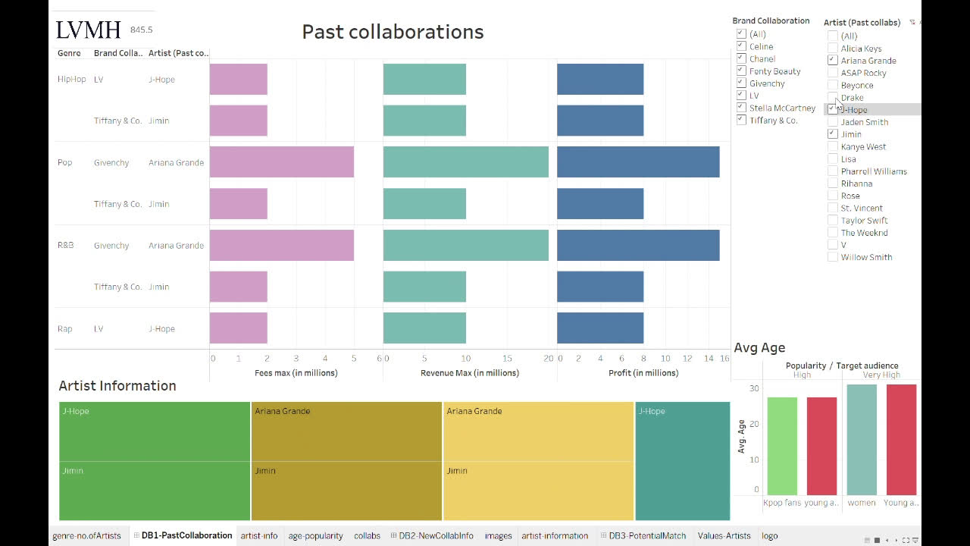
Past collaboration Artists

Slide 9
CONTRACT STAGE
Artist Identification
LVMH House Identification
Project Scope
Compensation

Slide 10

Contract Termination
Maturity
Termination for Cause

Slide 11
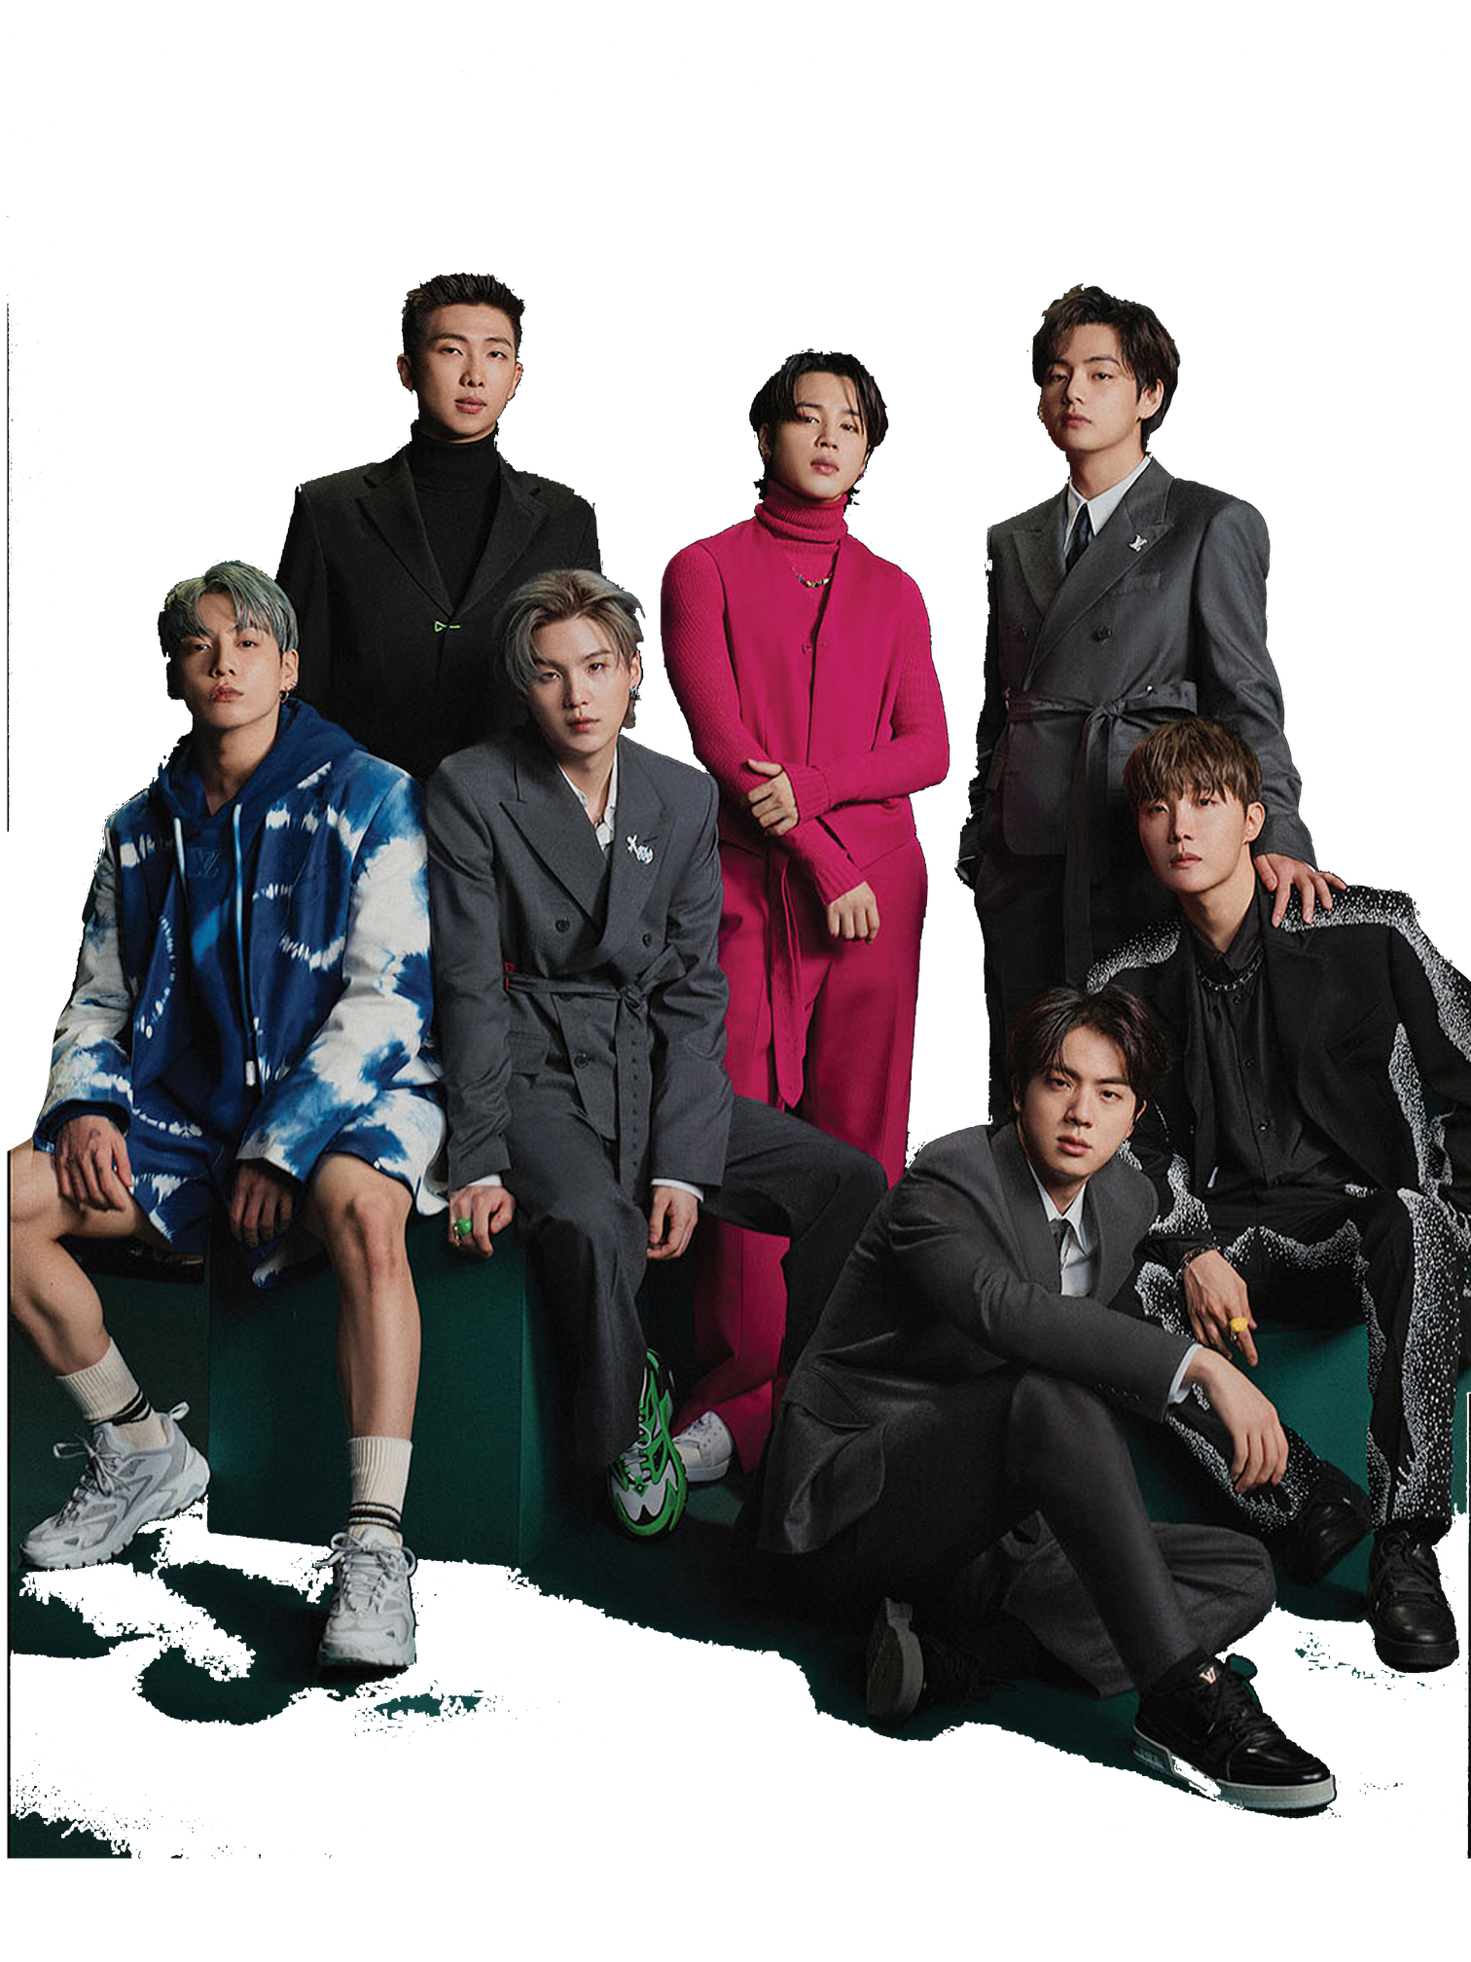
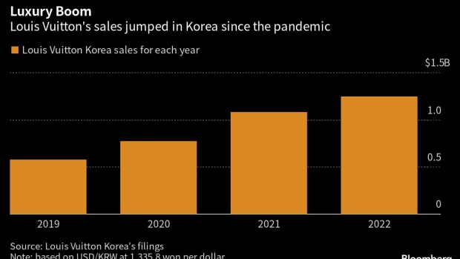
PROBLEM SOLVED!
BTS X LOUIS VUITTON
Daniel saved time and created an impactful collaboration

Slide 12

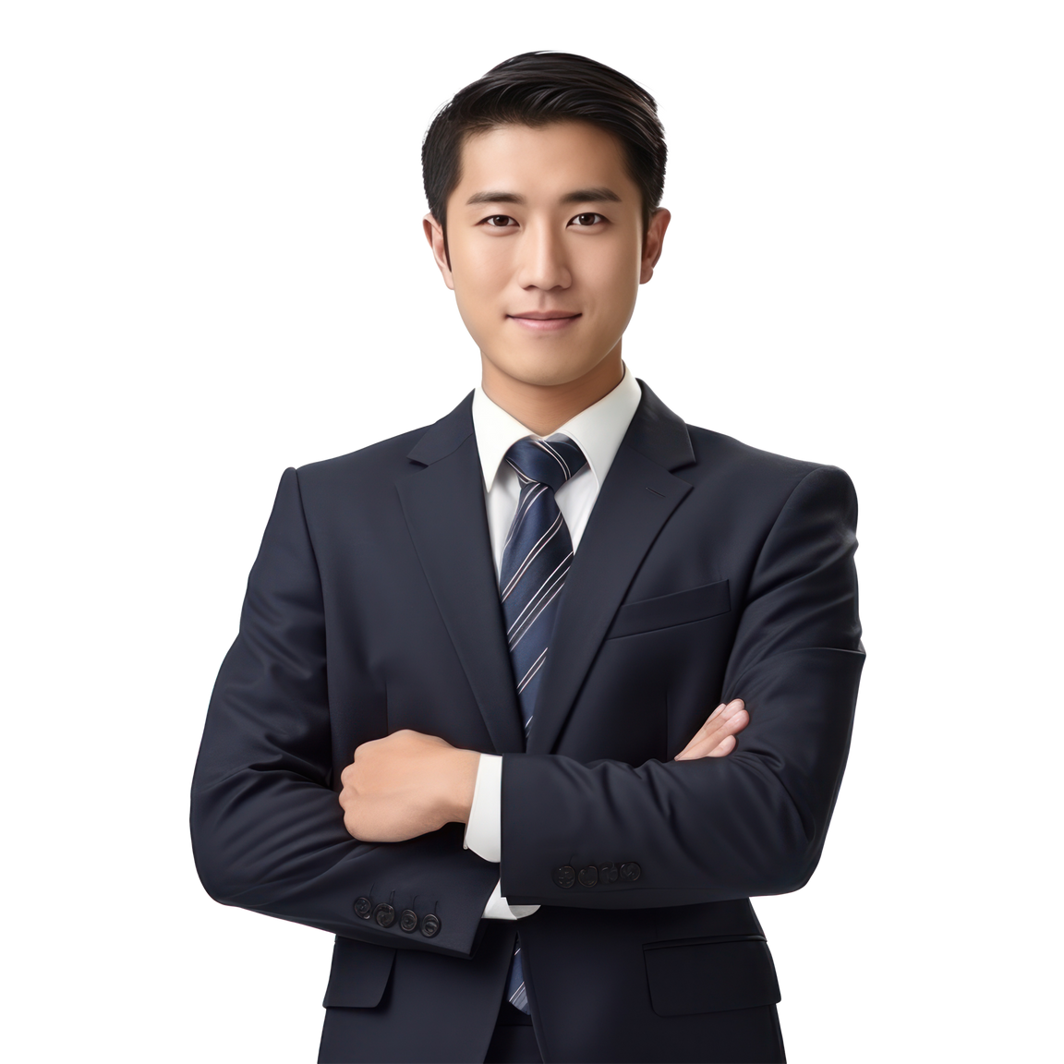


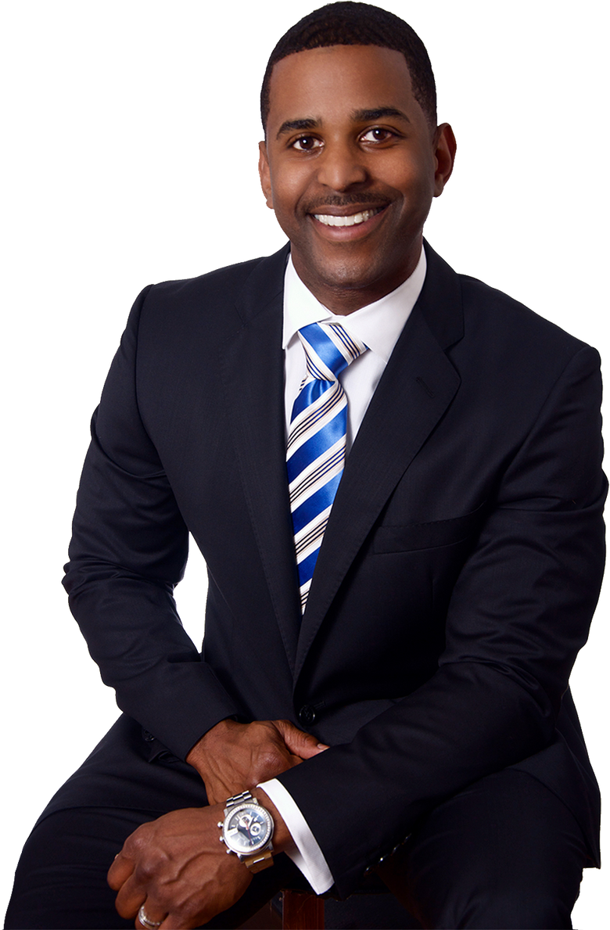
MUSEACO
For every Brand Manager

Slide 13
MUSEACO
MUSIC x EASY x COLLAB
THANK YOU!

